Slide 1
ETS The magic underneath the shell
Mathias R. Jessen
@IISResetMe
#psconfasia

Slide 2

whoami /claims
Professionally
Security Administrator, Threat Management Team @ Booking.com
Reads a lot of Perl/JavaScript/Go/C#, writes very little
Recovering web developer, ops person, heckler
Privately
Obsessed with PowerShell
Addicted to StackExchange and Black (?:Liquorice|Metal)

Slide 3
The mystery of Rob’s $Profile
$Profile is a [string]
but it behaves differently from normal string?!

Slide 4
PowerShell as a glue language
Based on .NET, powerful reflection
Ease of interaction with:
XML
WMI/CIM
COM interfaces
ADSI/DirectoryEntry
Native .NET objects
etc.
Notes:
Demo:
$Profile – a string, but not really?

Slide 5
PowerShell as a glue language
But how?
Notes:
Demo:
$Profile – a string, but not really?

Slide 6
PowerShell as a glue language
Extended Type System
Adapting Type System
Notes:
Demo:
$Profile – a string, but not really?

Slide 7
Type classifications
Primitive types
int, byte, bool
Composite types
enums, structs, arrays
Abstract types
classes, functions*

Slide 8
What is a (data)type?
Core property of a object
Contract for behaviour
(Typically) contract for operator behaviour
Not specific to OOP

Slide 9
What is a Type System?
The set of rules that govern types!
Aim:
Reduce runtime errors
Side effects:
Memory optimization
Enhanced reflection
Usually includes a core set of types that are natively recognized
May include extensible types

Slide 10
Language-specific Types
Javascript:
String, Number, Boolean, Array, function(), Object
Perl:
Scalar, Array, Hash
Java/C#
Object <- everything else extends this

Slide 11
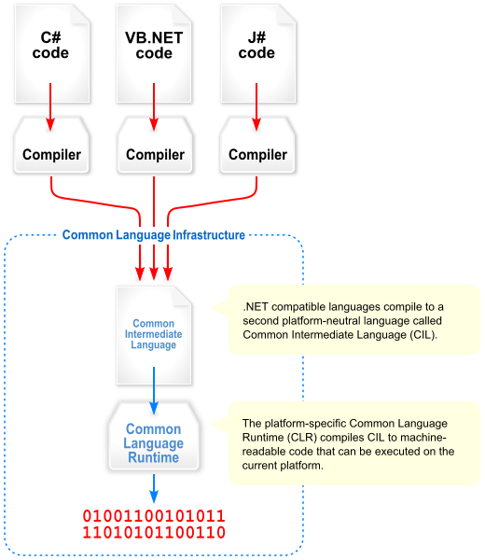
.NET and CLI

Slide 12
.NET and the Common Type System
Language-specific type constraints
that map onto CTS
Type System
Values
(primitive/value types)
Objects
(abstract/reference types)
CTS
Generics requirements
Metadata requirements

Slide 13
.NET and the Common Type System
Unified Type System (Everything is Object)
Builtin types map onto primitive value types
C# Spec
Type System
Values
(primitive/value types)
Objects
(abstract/reference types)
CTS
Generics requirements
Metadata requirements

Slide 14
.NET and the Common Type System
Abstract enough to allow language-specific type systems
Specific enough to guarantee language interoperability
Notes:
F# + C# demo

Slide 15
PowerShell and the Extended Type System
Everything is a PSObject!
PSObject acts as an implicit wrapper around objects
PSObject provides an adapted view of the underlying value
Notes:
F# + C# demo

Slide 16
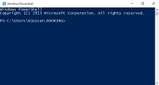
PSObject Layer
PSTypeNames
$_.PSBASE
(original .NET object)
$_.PSEXTENDED
Extended view
PSStandardMembers
$_.PSOBJECT
Adapter(Set)
$_.PSADAPTED
Adapted view (what we see in the shell)

Slide 17
Type System Taxonomy
Static/Dynamic typing
Compile-time vs Runtime-time type checks
Static: Strong/Weak typing - Dynamic: Explicit/Implicit typing
Are context types declared or inferred from value expressions?
Safe/Unsafe typing
Will unexpected type interactions throw errors or cause weirdness?

Slide 18
Type System Taxonomy - PowerShell
PowerShell is
Dynamic
Magic happens at runtime
Implicit (Explicit typing optional)
$var = Get-Value
[string]$var = Get-Value
Safe
.NET is inherently memory safe (until you tell it not be)

